Slide 1
Variables, Bindings, and Scope
CMSC 330: Programming Languages

Slide 2
Variables are necessary with imperative languages
Imperative languages are abstractions of the von Neumann Architecture
  Variables abstract memory
  Operations/instructions abstract CPU
Variables are defined by a set of attributes
  These attributes are common across all languages
  These attributes can affect the behavior of the program

Slide 3
Naming
Case Sensitivity
  myInt vs MyInt vs MYINT
  Can reduce readability (similar looking but different)
Length
  Should a min/max length be imposed?
  C99: no limit, first 63 characters are significant
  Java/C#: no limit, all characters are significant
  C++: no limit, but implementors (compiler developers) usually set their own limits

Slide 4
Naming Conventions
PHP: all variable names must begin with $
Perl: first character indicates the data type
  $: scalar (single value) @: array %: hash (map)
Fortran (older versions): first letter determines type
Ruby: prefix determines scope
  @: instance variables @@: class variables
OCaml: Capital first letter for discriminator or module (e.g., List)

Slide 5
A variable is characterized by six attributes:
  Name (identifier)
  Address (memory location)
  Value
  Type
  Lifetime (time during which the variable exists in memory)
  Scope (region of the program where the variable is visible)

Slide 6
Name
  An Identifier for the variable
  Not all variables have names
Address
  Location in memory associated with the variable
  A variable may have difference addresses at different time
  When two variables have the same address, they alias one another. Aliasing reduces readability and reliability.
  Abstract memory cell: collection of physical bytes associated with one variable

Slide 7
Type
  Determines the range of possible values
  Determines the set of possible operations
Value
  Two types of values: l-value and r-value
    l-value: the address of the variable; can appear on the left-hand side of an assignment
    r-value: the content stored in a location; can appear on the right-hand side of an assignment

Slide 8
Bindings
A binding is an association between an entity and an attribute
E.g.,
  Variable and its type
  Variable and its value
  Symbol and operation
Binding time: when the association is formed
Lifetime: duration the binding is valid

Slide 9
Possible Binding Times
Language Design Time
  Bind operator symbols to operations
Language Implementation Time
  Bind floating-point type to representation
Compile Time
  Bind a Java variable to a type
Load Time
  Bind a C/C++ static variable to a memory cell
Run Time
  Bind a non-static variable to a memory cell

Slide 10
Static Binding
  First occurs before runtime and remains unchanged
Dynamic Binding
  First occurs during execution or can change

Slide 11
Type Binding
Explicit: the type is clearly declared
Implicit: omit the type, letting the language processor infer it
  OCaml, C++ (auto), Java/C# (var)
When does the binding take place?
  Compile time? Run time?
Can type change as program runs?
  Yes: JavaScript, Python, Ruby, Perl
  No: Java, C, C++, Swift, OCaml

Slide 12
Dynamic Type Binding
Type of a variable is bound at runtime, or can change
  lst = [1, 2, 3] # does not matter what lst was before
Advantages?
  Flexibility
  Ease of use
Disadvantages?
  Costly (must do type checking at run time) in space/speed
  Vars have runtime type descriptors
  Type error detection can be difficult/impossible
  Usually implemented with interpretation so at least 10x slower

Slide 13
Lifetime
The lifetime of a variable is the time during which it is bound to a particular memory cell
Cells can be allocated or deallocated
  Allocation – getting cells from pool
  Deallocation – returning cells to pool
Four different categories of lifetime
  Static
  Stack-dynamic
  Explicit heap-dynamic
  Implicit heap-dynamic

Slide 14
Static
Storage bound prior to program execution
Binding cannot change (but value can)
Advantages
  Direct addressing (one pointer dereference)
  No runtime overhead for allocation/deallocation
  History sensitive
Disadvantages
  Inflexible (no recursion)
  Space cannot be reused by multiple subprograms
Notes:
A variable is history sensitive if it:
retains its value between function calls

Slide 15
Stack-Dynamic
A variable whose storage is allocated on the runtime stack when a block/function is entered, and deallocated when that block/function exits.
Advantages
  Supports recursion naturally
  Efficient use of memory (local, temporary storage)
  Fast allocation and deallocation (stack operations)
Disadvantages
  Small runtime overhead for stack management (usually minimal)
  Not history sensitive
  Requires indirect access (relative to stack pointer or frame pointer)

Slide 16
Explicit Heap Dynamic
Allocated and deallocated by explicit directives (new/delete)
Takes effect during execution
Referenced only through pointers
Advantages
  Dynamic storage management
Disadvantages
  Inefficient
  Unreliable

Slide 17
Implicit Heap Dynamic
Bound to heap storage by assignment statement
E.g., all arrays/objects in JavaScript, Perl, PHP
Advantages
  High flexibility (generic code)
Disadvantages
  Inefficient – all attributes are dynamic
  Loss of error detection, i.e., many errors that could be caught at compile time are only found at runtime.
Notes:
Why this is inefficient
Because the system must:
allocate objects on the heap
track references for garbage collection
perform type checking at runtime
possibly reallocate or wrap values

Slide 18
Scope
Range of statements over which a variable is visible
Scope rules: determine how each use of a name (identifier) is matched to the correct variable.
To connect a name reference to a variable, you (or the compiler) must find the declaration
Static Scope:
  Based on the structure of the program
Dynamic Scope:
  Based on the execution of the program
Notes:
When you write a program, you may have many variables with the same name in different places.
Scope rules tell the compiler/interpreter:
“Which variable does this name refer to right now?”

Slide 19
Constructs That Create Scope
Blocks
  A compound statement that introduces a local region of scope
  Creates a new scope level automatically
  Shadowing:
    Allowed in C and C++, Restricted or disallowed in Java and C#
Let Expressions
  Common in functional languages
  Consist of two parts: Bindings and Body expression
  Scope is limited to the body expression
Notes:
Shadowing happens when a variable declared in an inner scope has the same name as a variable in an outer scope. The inner one “hides” the outer one within its scope.
int x = 10;
int main() {
int x = 20; // shadows global x
{
int x = 30; // shadows outer x
std::cout << x; // prints 30
}
std::cout << x; // prints 20
}

Slide 20
Scope Categories
Local variables
  Declared within a function or block
Nonlocal variables
  Not declared locally but visible within a unit due to enclosing scopes
Global variables
  Declared in the outermost scope
  Visible throughout the program (after declaration)

Slide 21
Static Scope Rules
Scope is determined by program structure (source code layout)
Name resolution process:
  Search locally first
  Then search outward through enclosing lexical scopes
  Continue until a declaration is found
Terminology:
  Static parent: immediately enclosing scope
  Static ancestors: all enclosing scopes outward
A variable can be shadowed by a closer declaration with the same name

Slide 22
int x = 3;
int main() {
std::cout << x << '\n'; // 3
int x = 4;
{
int x = 5;
{
std::cout << x << '\n'; // 5
int x = 6;
std::cout << x << '\n'; // 6
}
std::cout << x << '\n'; // 5
}
std::cout << x << '\n'; // 4
}

Slide 23
Dynamic Scope Rules
Scope is determined at runtime based on call history
Name resolution process:
  Search local environment first
  Then follow the call stack backward
  Use the most recent active binding
Visibility depends on which functions are currently active
Behavior is temporal (runtime-dependent)
Shadowing: A variable in a more recent activation record hides older ones with the same name

Slide 24
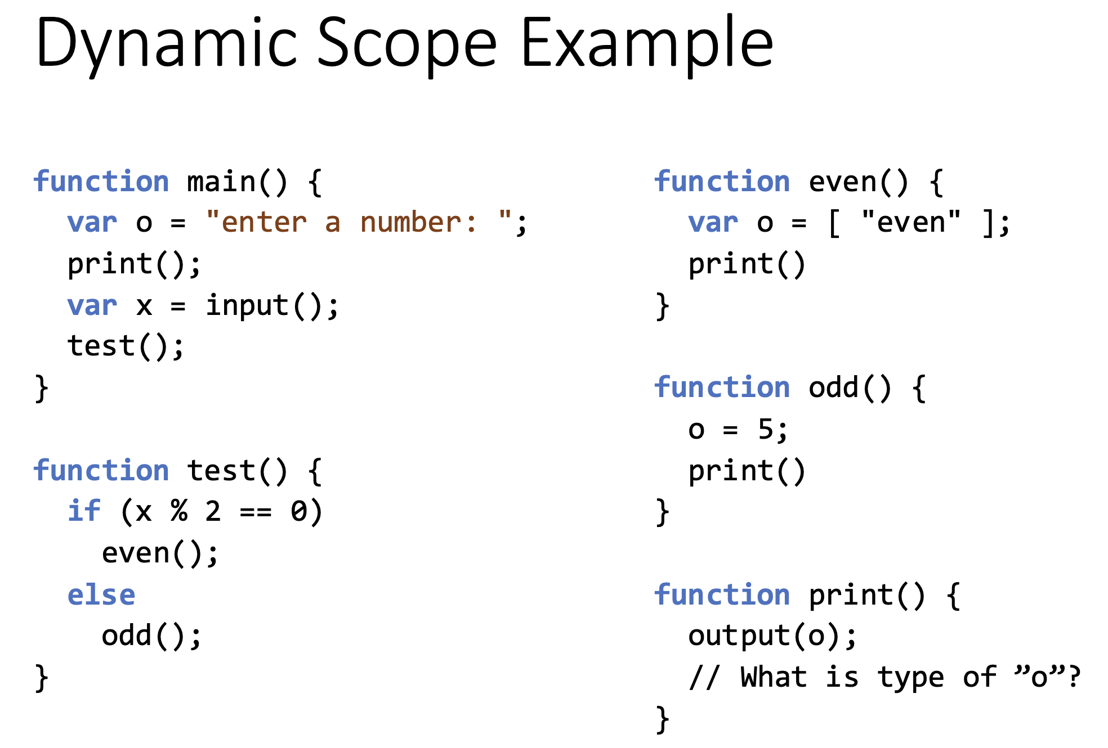

Slide 25
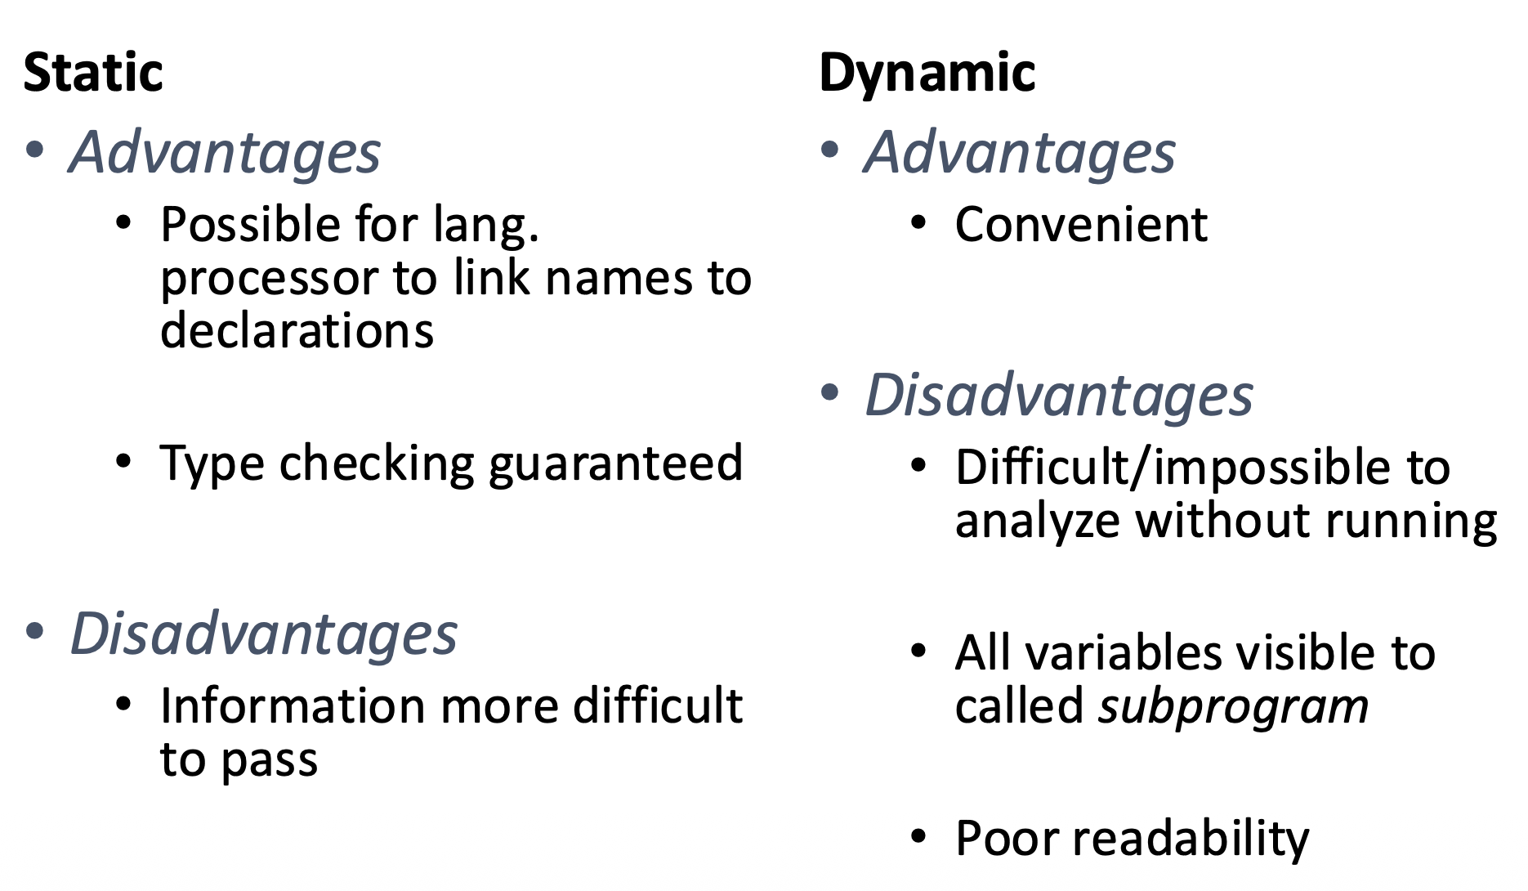
Static vs Dynamic Scope

Slide 26
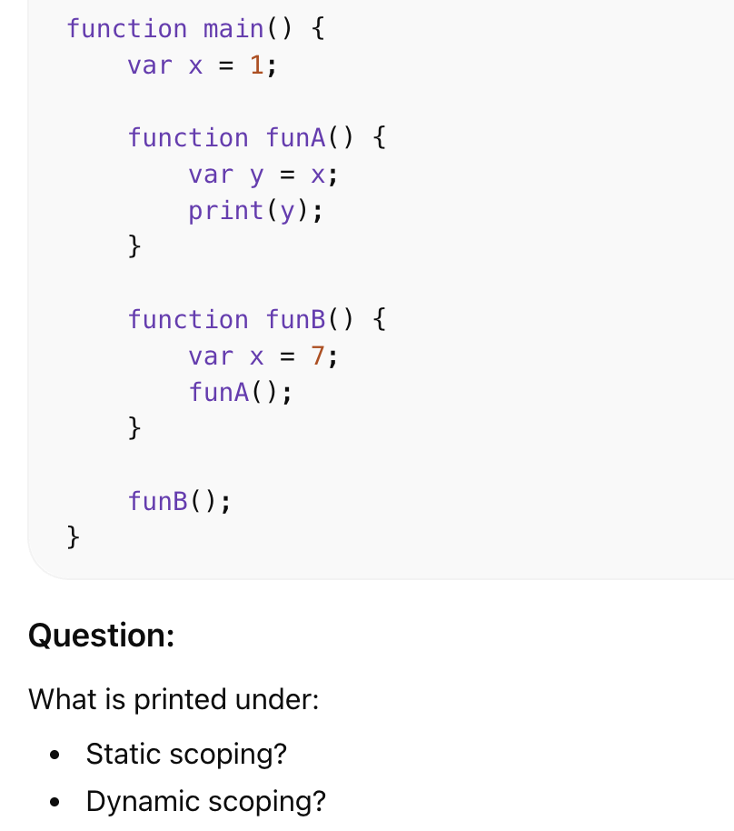
Notes:
Static (lexical)1. Dynamic7

Slide 27
Referencing Environments
The referencing environment is the set of all visible names at a program point
Static-scoped languages:
  Local variables + all variables in enclosing lexical scopes
Dynamic-Scoped Languages:
  Local variables + all variables in all active (currently executing) subprograms

